Slide 1
Dynamic Programming
Gogos Christos
November 2019
Department of Informatics and Telecommunications
University of Ioannina

Slide 2
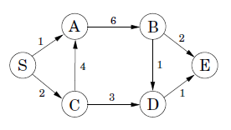
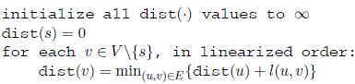
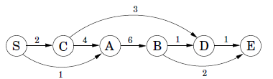
Shortest path in a DAG
Linearization of a DAG

Slide 3


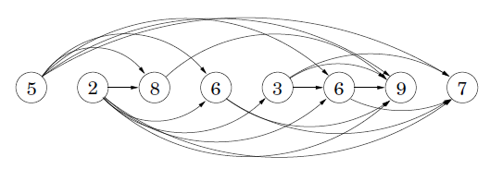
Longest increasing subsequence problem
Implicit DAG

Slide 4


Edit distance problem
A natural measure of the distance between two strings is the extent to which they can be aligned, or matched up.
Example: SNOWY vs SUNNY
A dynamic programming solution
x[1..m] is the first substring
y[1..n] is the second substring
Subproblem E(i,j): find the edit distance between a prefix of the first substring x[1..i] and a prefix of the second substring y[1..j]
E(7,5)

Slide 5


Express subproblem in terms of smaller subproblems
Problem E(i,j)
Find the best alignment between x[1..i] and y[1..j]
The rightmost column can only be one of three things:
EXPONENTIAL vs POLYNOMIAL
E(4,3) refers to EXPO vs POL
+1 cost
remains to align x[1..i-1] and y[1..j]
+1 cost
remains to align x[1..i] and y[1..j-1]
+1 cost if x[i]≠y[j]
remains to align x[1..i-1] and y[1..j-1]

Slide 6
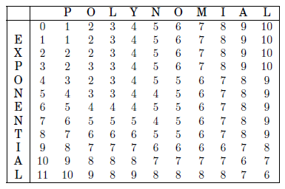
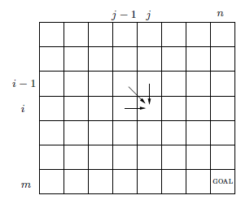
Table of subproblems
The table of subproblems
The final table of values found by dynamic programming

Slide 7
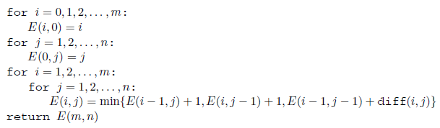

Algorithm and the base cases
Base cases:
E(i,0) is the edit distance between the 0-length prefix of y (the empty string) and the first letters of i ➔ E(i,0)=i
Similarly E(0,j)=j
The procedure fills in the table row by row, and left to right within each row
Each entry takes constant time to fill in, so the overall running time is just the size of the table, O(mn)
Edit distance = 6

Slide 8
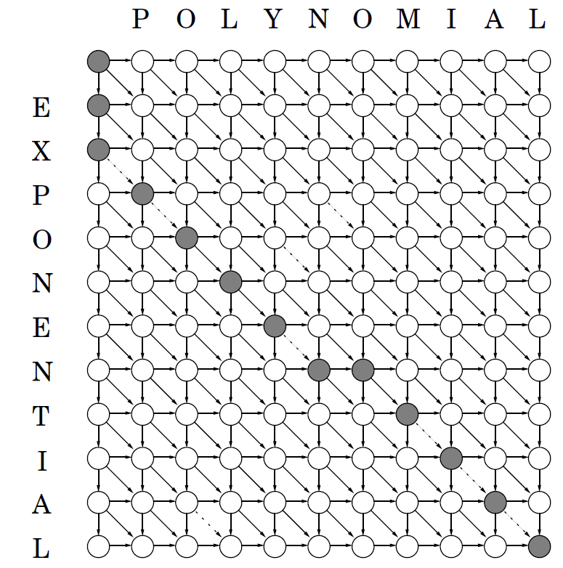
The underlying DAG
Edges:
(i-1,j)→(i,j)
(i,j-1)→(i,j)
(i-1,j-1)→(i,j)
Set all edge lengths to 1, except for:
{(i-1,j-1)→(i,j): x[i]=y[j]}
shown dotted in the figure
Each move:
down → deletion
right → insertion
diagonal → match or substitution

Slide 9
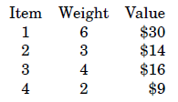
Knapsack problem
During a robbery, a burglar finds much more loot than he had expected and has to decide what to take
His bag (or “knapsack”) will hold a total weight of at most W
There are n items to pick from, of weight w₁,…,w_{n} and dollar value v₁,…, v_{n}
What's the most valuable combination of items he can fit into his bag?

Slide 10
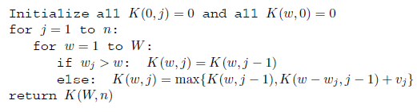
Subproblem definition + DP algorithm
K(w,j): maximum value achievable using a knapsack of capacity w and items 1,…,j
The answer we seek is K(W,n)
We can express K(w,j) in terms of problems K(.,j-1)
either item j is needed to achieve the optimal value, or it isn’t needed

Slide 11
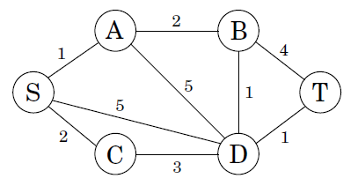

Shortest reliable paths
Find the shortest path from s to t that uses at most k edges
In dynamic programming, the trick is to choose subproblems so that all vital information is remembered and carried forward
Define for each vertex v and each integer i≤k, dist(v,i) to be the length of the shortest path from s to v that uses i edges
The starting values dist(v,0) are ∞ for all vertices except s, for which it is 0

Slide 12
All-pairs shortest paths
We want to find the shortest path between all pairs of vertices
Approach 1: execute |V| times the shortest path algorithm, once for each starting node, O(|V|²E)
Approach 2: Dynamic Programming, Floyd-Warshall algorithm, O(|V|³)
When no intermediate nodes are allowed, the shortest path from u to v is simply the direct edge (u,v), if it exists
We expand the set of permissible intermediate nodes (one node at a time), updating the shortest path lengths at each step
Eventually this set grows to all of V, at which point all vertices are allowed to be on all paths, and we have found the true shortest paths between vertices of the graph

Slide 13
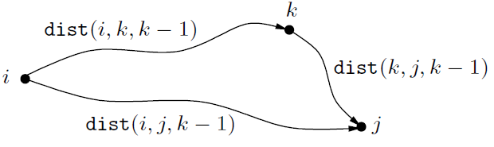
All-pairs shortest paths subproblems
Number the vertices in V as {1,2,…,n}
dist(i,j,k): length of the shortest path from node i to node j in which only nodes {1,2,…,k} can be used as intermediates
dist(i,j,0)=length of the edge between i and j if it exists, ∞ otherwise
Expand the intermediate set to include an extra node:
reexamine all pairs i,j and check whether using k as an intermediate point gives us a shorter path from i to j

Slide 14

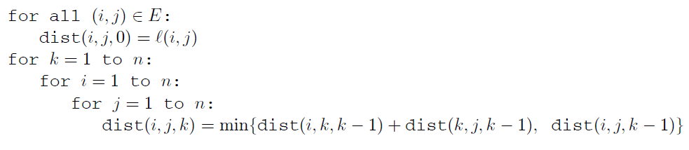
Floyd-Warshall algorithm

Slide 15
Sources
Algorithms. S. Dasgupta, C. H. Papadimitriou, and U. V. Vazirani, 2006

